Slide 1
Regression
Final Presentation
Group - 3
Kunal Nema - MA20BTECH11007

Slide 2
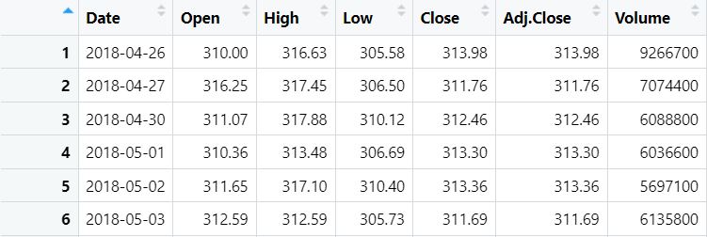
Data Description
Netflix Stock Price Data of 5 years
Downloaded from yahoofinance.com
1258 instances, 7 attributes

Slide 3
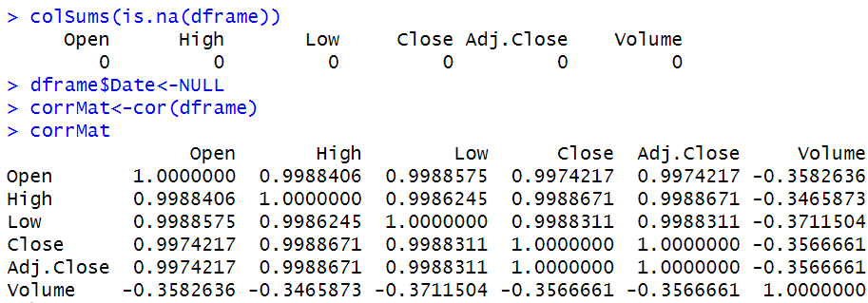
Data Preprocessing
Check if any NA values are present in data
Removing the unnecessary features (non-numeric)
Correlation Matrix

Slide 4
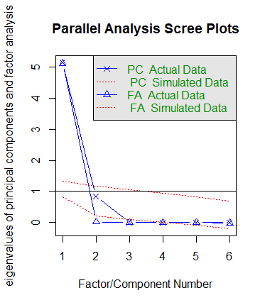
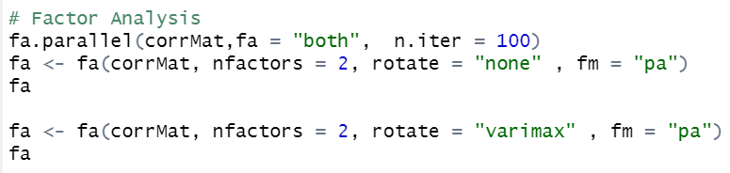
Factor Analysis
Scree plots after 100 iterations
Parallel Analysis suggest number of factors = 2

Slide 5

Initial Linear Regression Model
Dependent Variable: Close
Independent Variables: Open, High, Low, Volume

Slide 6
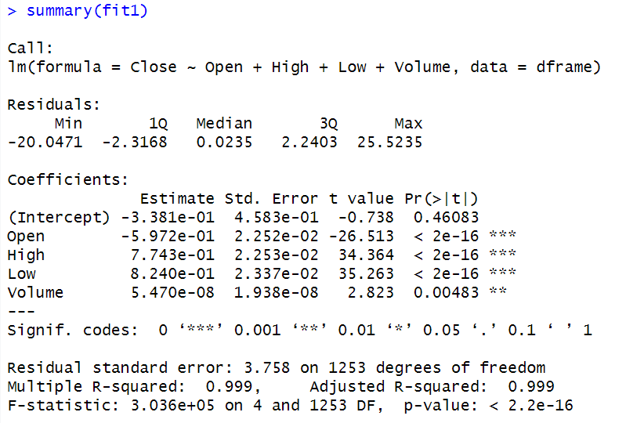
Summary of fit1
P-values: Significance of each independent variable
F-statistic: Statistically significant
Multiple R-squared: Model explains 99% of variance in dependent variable
Adjusted R-squared: Great fit

Slide 7
Assumptions of Linear Model
Linearity
Normality
Multicollinearity
Homoscedasticity
Autocorrelation

Slide 8

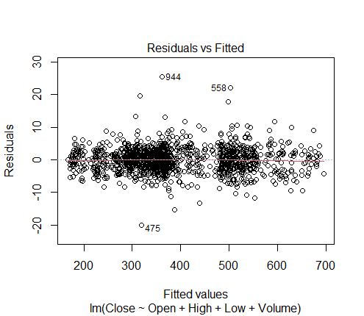
Test for Linearity
Residuals vs Fitted Plot
Model is Linear

Slide 9
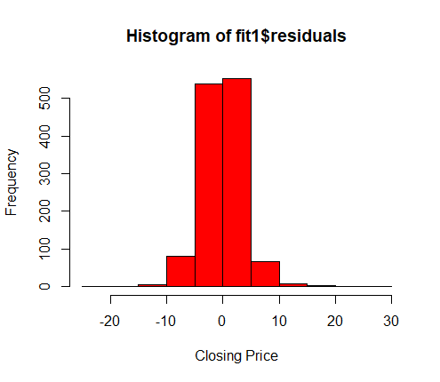
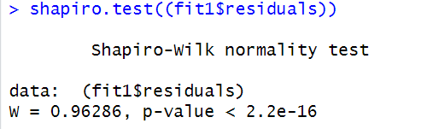
Test for Normality
Visual Test from Histogram: Not Normal
Shapiro Test (p-value < 0.05): We reject the null hypothesis, i.e. model is normal

Slide 10

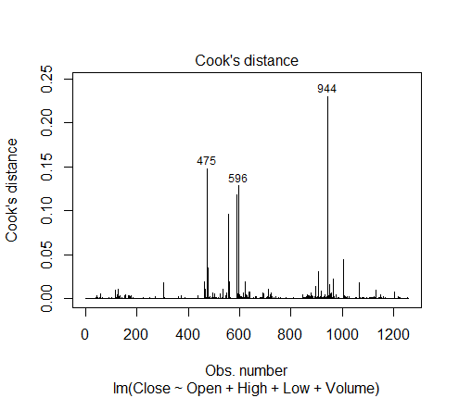
Checking Outliers
Outliers: Extreme values of dependent variables and large residuals
Great Effect on regression model
Top 3 outliers: #475, #596, #966

Slide 11
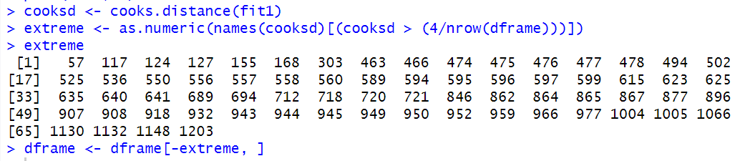
Removing Outliers
Calculate cook’s distance of all points for fit1
Store points having cook’s distance greater than a specific value
Remove these extreme values from the dataframe

Slide 12
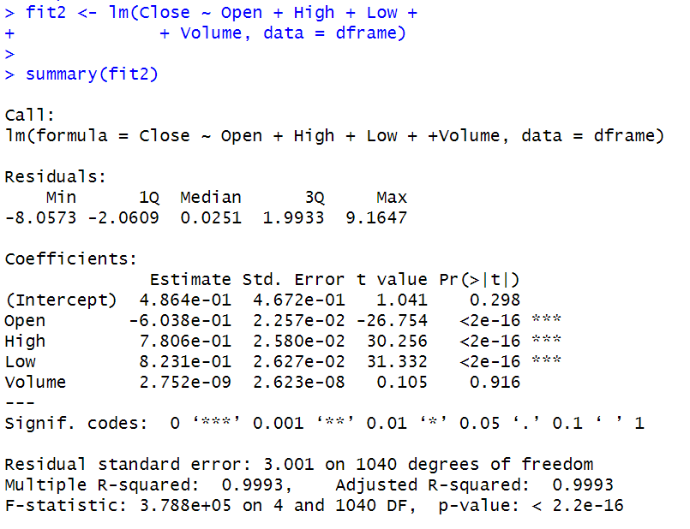

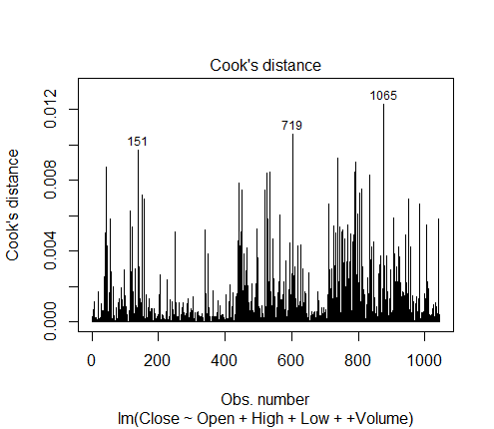
Updating Linear Model

Slide 13
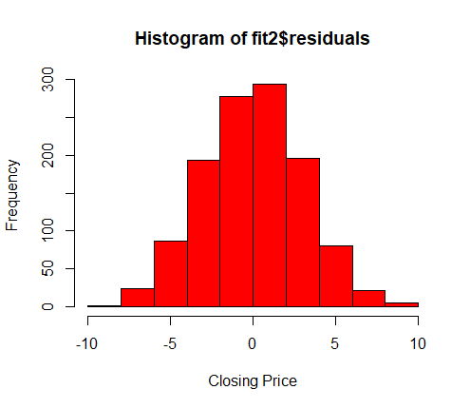
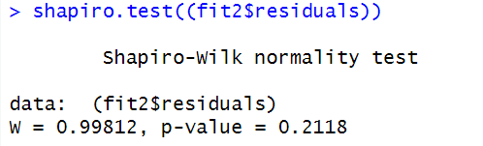
Normality of updated model
Histogram Test: Normal
Shapiro Test (p-value > 0.05): We fail to reject the null hypothesis that model is normal

Slide 14

Test for Multicollinearity
Variance Inflation Factor Test
Open, High and Low have very high correlation with each other
Multicollinearity exists

Slide 15
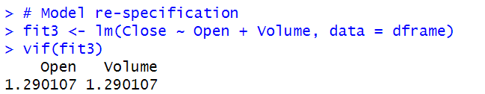
Model Re-Specification
Drop High and Low variables
Multicollinearity is removed

Slide 16
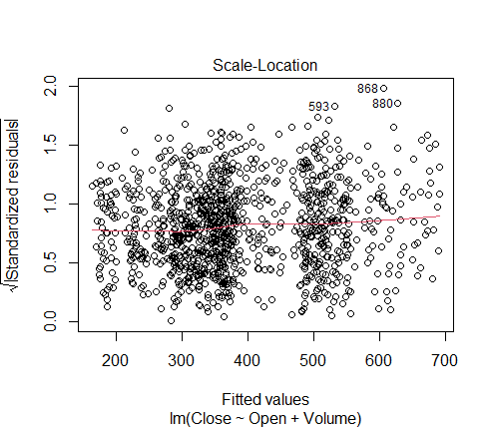
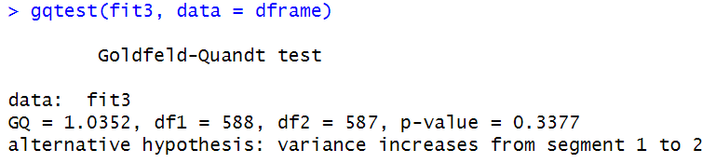
Test for Heteroscedasticity
Scale-Location Plot: Homoscedastic
Goldman-Quant Test (p-value < 0.05): We reject the null hypothesis. We don’t have sufficient evidence to say that heteroscedasticity is present in the model.

Slide 17
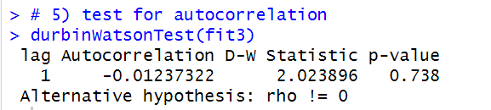
Test for Autocorrelation
H0: autocorrelation does not exist
Durbin-Watson Test (p-value > 0.05): We fail to reject the null hypothesis that autocorrelation does not exist

Slide 18
Thank You

